Slide 1

Data Acquisition
Notes:
Now you have learned some basic concepts of digital forensics. In today's lesson, we're going to learn data acquisition, which is an important concept in digital forensics.

Slide 2


Crime Scene Investigation
Let your hypotheses fly
Crime scene
Notes:
When a crime occurs, some detectives will be called on to the crime scene for investigation. They develop many hypotheses to explain what happened.

Slide 3


Crime Scene Investigation (cont’d)
Evidence!
Investigators
Crime scene
Notes:
Then, the detectives look for evidence to test hypotheses, either supporting or refute these hypotheses.

Slide 4

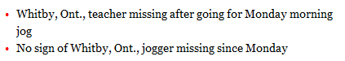
Crime Scene Investigation (cont’d)
Jeffrey Boucher case
Notes:
Let’s take a look at a real case happened in Ontario, Canada. Jeffrey Boucher, a teacher, was missing after going out for Monday morning jog.

Slide 5


Crime Scene Investigation (cont’d)
Search the area turned out nothing
background check on Boucher turned up nothing suspicious.
Investigators are monitoring his email address, facebook acount, bank accounts, health card and passport, but have not detected any activity.
Fell during his run
or
Foul play
or
Walked away from his life
Etc.
Boucher, 52, disappeared Jan. 13 after apparently going on one of his daily jogs
Jeffrey Boucher case
Notes:
During the investigation, the police developed some hypotheses, for example,
Fell during his run or Foul play or Walked away from his life.
But, all the hypotheses are disproved after some investigation.
For example, investigators are monitoring his email address, facebook acount, bank accounts, health card and passport, but have not detected any activity. It means he didn’t walk away from his life.

Slide 6

Mission and Objectives of Forensic Investigations
Discover Forensic Evidence
Let Justice be served
Notes:
The mission and objectives of forensic investigations are to discover Forensic evidence, find out the truth, and catch the wrongdoer(s) to let justice be served.

Slide 7






Dose of Reality:
Here is your evidence your honor
I found it at the crime scene!
The accused knife is found at the scene of the crime?
Notes:
Presenting physical evidence in court is very straightforward.
For example, you present a murder weapon which contains the fingerprint of the suspect. While you could be challenged by the defense lawyer, for example, whether the murder weapon is found at the crime scene. However, the detective who found it at the crime scene can be called as a witness to prove it.

Slide 8
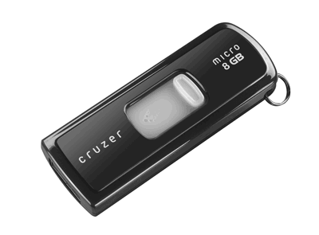




Here is your evidence your honor
dcfldd
Analysis
Forensic Image
The hash values are the same.
Notes:
However, simply presenting the USB flash drive found at the crime scene is not enough. Instead, data stored on the disk must be collected and analyzed.
For example, the USB thumb drive will be imaged using dcfldd. Note that dcfldd is an improved version of dd, which is a Linux utility for disk clone and data duplication.
Also, a hash value of the disk image should be computed and documented to guarantee that the disk image has been preserved properly and the same disk image is used for analysis.
Finally, the data contained in the disk image is analyzed for evidence, for example, inappropriate images, which can be presented in front of The Judge and Jury so they can understand.
It is similar to a detective presenting the analysis of a fingerprint collected at a crime scene.

Slide 9
Data Acquisition
Data acquisition in digital forensics encompasses all the procedures involved in gathering digital evidence including cloning and copying evidence from any electronic source.
It involves producing a forensic image from digital devices including CD ROM, hard drive, removable hard drives, smartphones, thumb drive, gaming console, servers, and other computer technologies that can store electronic data.
In digital forensics investigation, data acquisition is perhaps the most critical stage and it involves a demanding, thorough, and well-crafted plan for acquiring digital evidence
[1] HOW TO HANDLE DATA ACQUISITION IN DIGITAL FORENSICS
https://blog.eccouncil.org/how-to-handle-data-acquisition-in-digital-forensics/
Notes:
Data acquisition in digital forensics covers all the procedures involved in gathering digital evidence including cloning and copying evidence from any electronic source.

Slide 10
Types of Acquisition
Two types of data acquisition
Static acquisition
Copying a hard drive from a powered-off system
Used to be the standard
Does not alter the data, so it's repeatable
Live acquisition
Acquire data while the system is running
Now the preferred type, because of hard disk encryption
A second live acquisition will not be the same.
Notes:
There are two main types of data acquisition.
Static Acquisition: It acquires data from the original media. The data in the original media will and must not change.
Live Acquisition: It acquires data while the system is running. It is now the preferred type if the computer is still running, because of hard disk encryption
Unfortunately, it cannot be repeated exactly since it alters the data:
In this lecture, we will focus on static acquisition. Live acquisition will be detailed later when introducing Volatile Data Forensic Analysis.

Slide 11
Digital Evidence Storage Formats
Raw formats
Raw Format Raw image format was originally used by dd
Bit by bit copying of the data from the disk
Many tools could be used
Proprietary formats
Vendors have special formats
Expert Witness format is the unofficial standard
Used by EnCase, FTK, X-Ways Forensics, and SMART
Can produce compressed or uncompressed files
File extensions .E01, .E02, .E03, …
Advanced Forensics Format
Developed by Dr. Simson L. Garfinkel of Basis Technology Corporation
Provides many advanced features (e.g., compressed or uncompressed image files)
Simple design with extensibility
Notes:
There are three digital evidence Storage Formats.

Slide 12
Data acquisition methods
Disk to Image File
Disk to Disk
Logical acquisition
Acquire only certain files if the disk is too large
Sparse acquisition
Similar to logical acquisition but also collects fragments of unallocated (i.e. deleted) data
[1] Nathan Scrivens and Xiaodong Lin. Android digital forensics: data, extraction and analysis. ACM TUR-C 2017
Notes:
There are different types of data acquisition methods including disk-to-image file, disk-to-disk copy, Logical acquisition, and sparse data copy of a file or folder.
There are also different approaches used for data acquisition. This will depend on the type of digital device you’re applying to. For instance, the approach you’ll utilize for retrieving evidence from a smartphone will be different from the technique needed to acquire digital evidence from a computer hard drive.

Slide 13
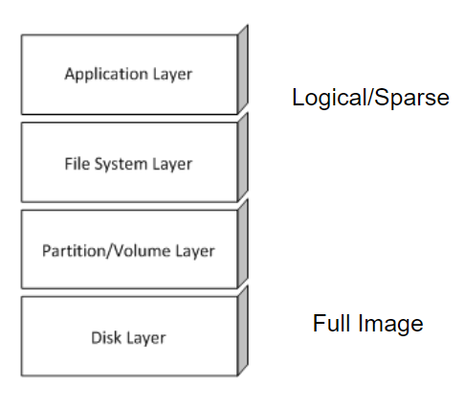
Data Acquisition Layers
Rule of thumb
Only image what you have to
Notes:
Data can be acquired at different layers. For example, you can grab or copy files only using logical acquisition at application layer, or image the entire hard disk at disk layer. However, the amount of data acquired will have a huge difference.
So the Rule of thumb is Only image what you have to.

Slide 14
Acquisition Architectures
How do we get data off the system?
Removal of the hard disk
Image elsewhere
Plug in to investigation system as an external disk
Boot the system with a live CD
OS lives in memory, hard disk image can be taken without the need to dismantle the system
Notes:
So how do we get data off the system?
There are two ways:
Removal of the hard disk, which is a traditional way. You remove the hard disk and image it elsewhere by plugging in to investigation system as an external disk
Or you boot the system with a live CD. So OS lives in memory, hard disk image can be taken without the need to dismantle the system

Slide 15
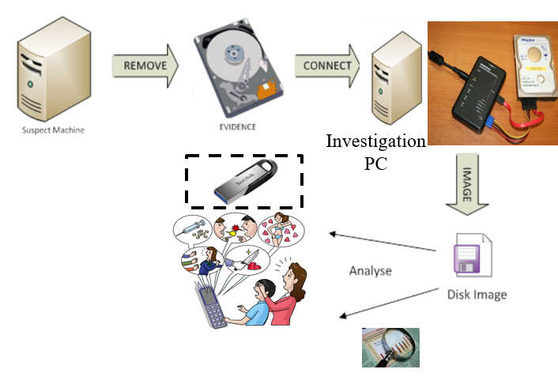
Traditional
Write Blocker
Notes:
The traditional way to get data off the system is to remove the hard disk. Or, yuo find a removable disk (USB usb flash drive).
Then, plug in to investigation system as an external disk.
One of the investigation guidelines was to modify the original data as little as possible. One of the promising methods is to use write blocker, which prevents any users from writing data to the storage device. Currently, there are two types of write blockers, hardware write blockers and software write blockers. We show a hardware write blocker here.
Afterwards, the disk image can be forwarded to digital evidence lab for analysis.

Slide 16
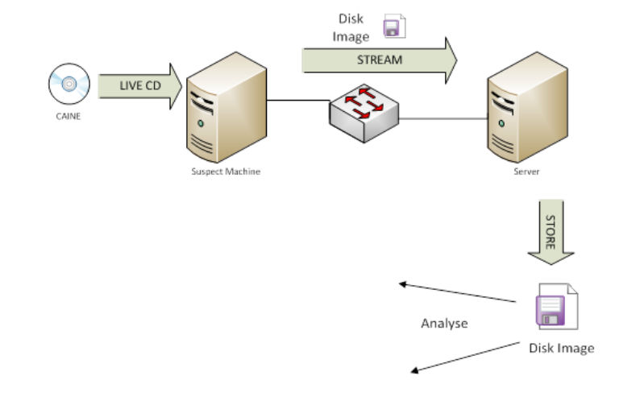
Live CD (Network) Acquisition
Notes:
Also, it is possible to Boot the system with a live CD which contains disk imaging tool. As such, hard disk image can be taken without the need to dismantle the system.
The disk image can be taken to digital evidence lab for analysis.

Slide 17
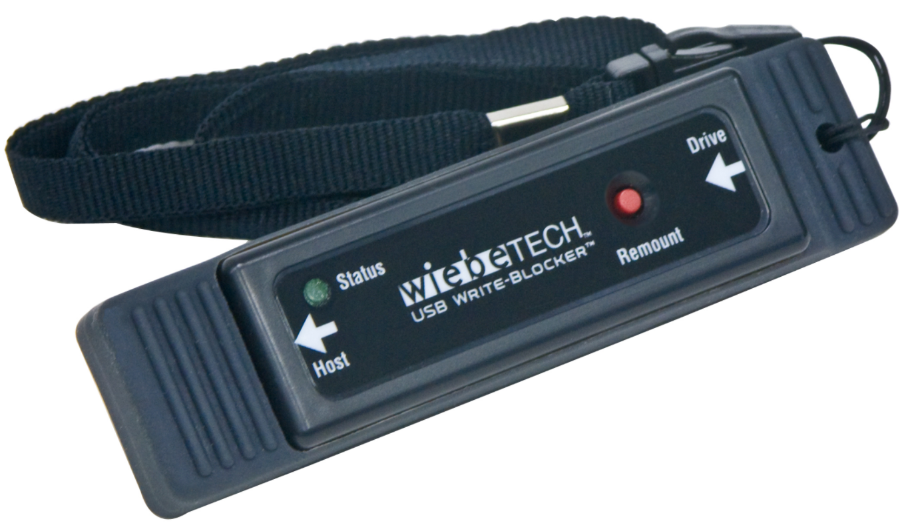
Write Blockers
It is important that the evidence drive is write protected.
Do not allow data to be written
Do not allow the disk to be mounted with write-access
Read-commands only
Can be done in Hardware and Software
USB Hardware Write Blocker
Notes:
As we just discussed, it is important that the evidence drive is write protected.
Currently, there are two types of write blockers, hardware write blockers and software write blockers.
For example, this is a USB hardware write blocker.

Slide 18
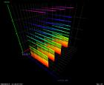
Non-graded hands-on exercise
- Software Write Block
In this non-graded lab exercise, you are required to add USB drive write protection to a computer system running the Windows operating system.

Slide 19

Panel Discussion
Non-graded hands-on exercise
- Software Write Block (cont’d)
Since many modern data acquisition techniques/tools don’t modify any of the original data, we don’t need write blockers anymore. Do you agree with this statement?
Notes:
I would like to have a panel discussion about why we need to use write blockers.

Slide 20
Validating Data Acquisitions
Most critical aspect of computer forensics
Create hash values – CRC-32 (older methods), MD5, SHA series
Linux validation – Hash algorithms are included and can be executed using special commands
Windows validation – No hash algorithms built in, but works with 3rd party programs
Notes:
We need to validate Data Acquisitions, Most critical aspect of computer forensics. For example, we can create hash values – CRC-32 (older methods), MD5, SHA series.

Slide 21
Acquisition Tools
Tool testing
NIST
Proprietary Tools
EnCase
FTK (FTK Imager)
ProDiscover
Open Source
DD
DCFLDD

Slide 22
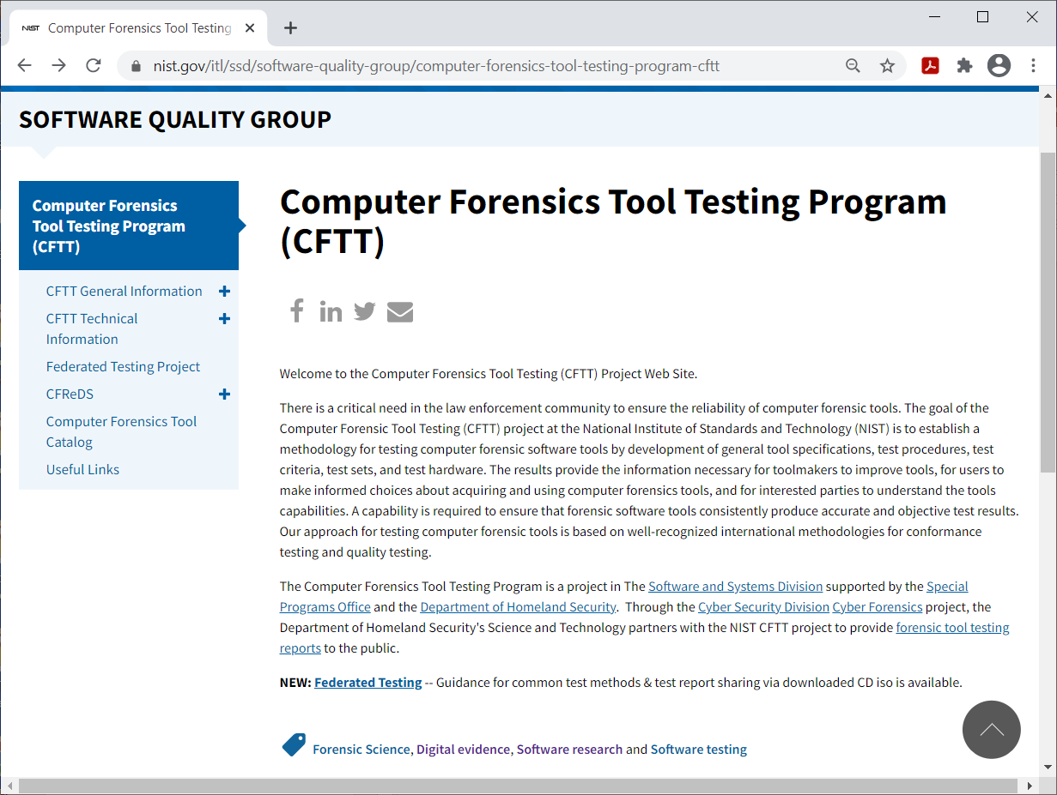
Notes:
The National Institute of Standards and Technology (NIST) has computer forensics tool testing (CFTT) project to ensure the reliability of computer forensic tools by testing various computer forensic tools based on well-recognized international methodologies for conformance testing and quality testing.
As a user, you can be well informed choices about acquiring and using computer forensics tools, and understand the tools capabilities. For the educational purposes, we will be using some popular open source tools in this class.

Slide 23
The Order of Volatility
Computers store a great amount of information in a significant number of locations and layers. Disk storage and Random access memory (RAM) are the two most commonly thought data repositories.
All data is volatile, however. As time passes the veracity of the information goes down, and the ability to recall or validate the data also decreases.
However, some data is MORE volatile.
[1] Order of volatility. http://www.macforensicslab.com/ProductsAndServices/
index.php?main_page=document_general_info&cPath=5_24&products_id=213
Notes:
Computers store a great amount of information in a significant number of locations and layers.
All data is volatile, however. As time passes the veracity of the information goes down, and the ability to recall or validate the data also decreases. However, some data is MORE volatile.
Your data acquisition must be based on the volatility of your forensic evidence. This means that you need to collect your digital forensics evidence based on their level of fragility. The most fragile evidence must be collected first, and later the least fragile evidence. The reason for this is to minimize any form of damage or data modification.

Slide 24

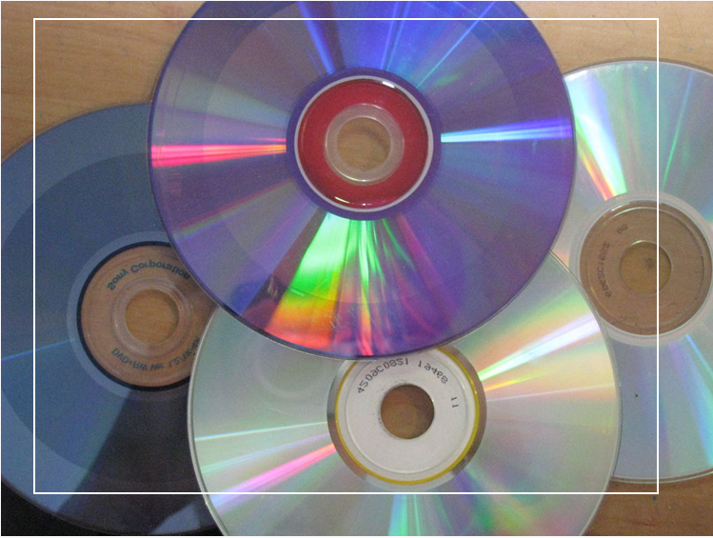
Data Acquisition and the Order of Volatility (cont’d)
A book published in 1857
unreadable DVD
Notes:
All data is volatile, even including hard copy books and DVD. For example, a book published in 1857 becomes unreadable. Also, a DVD may become unreadable after years.

Slide 25
Data Acquisition and the Order of Volatility (cont’d)
Thus, when collecting data for a computer forensic investigation you want to collect the most volatile data first as it will be lost the quickest.
- The order of volatility shows which data will be lost first.
[1] Order of volatility. http://www.macforensicslab.com/ProductsAndServices/
index.php?main_page=document_general_info&cPath=5_24&products_id=213
Notes:
Thus, when collecting data for a computer forensic investigation you want to collect the most volatile data first as it will be lost the quickest. The order of volatility shows which data will be lost first.

Slide 26
Data Acquisition and the Order of Volatility (cont’d)
high
Registers, peripheral memory, caches, etc. | nanoseconds
Main Memory | nanoseconds
Network state | milliseconds
Running processes | seconds
Floppies, Hard disk, backup media, etc. | years
CD-ROMs, printouts, etc. | tens of years
The order of volatility in which data will be lost first.
The expected lifespan of data
[1] http://www.porcupine.org/forensics/forensic-discovery/appendixB.html
Notes:
This is the expected lifespan of data. The shorter the expected lifespan of data is, the higher volatile the data is.
In an order of the most to the least fragile evidence, you should collect forensic evidence from main memory, network state information, kernel statistics, temporary file systems, remote logging and monitoring data that is relevant to the system in question, physical configuration, network topology, and finally from archival media, such as hard disks, CD-ROMs.

Slide 27
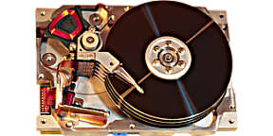
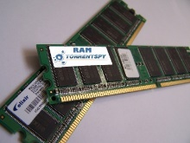

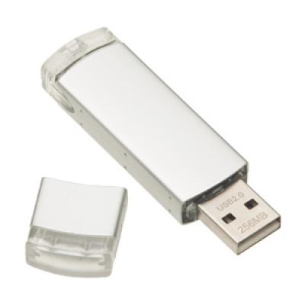
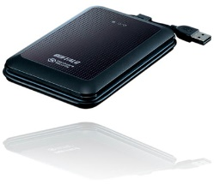
Digital Forensic Imaging
Digital Forensic Imaging is defined as the processes and tools used in copying a physical storage device for conducting investigations and gathering evidence. This copy does not just include files which are visible to the operating system but every bit of data, every sector, partition, files, folders, master boot records, deleted files and un-allocated spaces. The image is an identical copy of all the drive structures and contents.
Apply hash function to the data, and document the hash value
Acquiring Data
A Disk Image
[1] https://study.com/academy/lesson/digital-forensic-imaging-types-examples.html
Notes:
The most popular method for static data acquisition is disk-to-image file, aka Digital Forensic Imaging, which creates a forensics image of a disk.

Slide 28


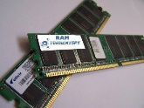
Digital Forensic Imaging Software
There are many digital imaging software available today. For example,
FTK Imager
Linux “dd” or “dcfldd”
The basic dcfldd syntax for creating a forensic image of a drive is:
dcfldd if=/dev/sdb of=/home/blah/newimage.dd bs=512
where if = input file (or in this case drive), of = output file, bs = block size in bytes
[1] https://techtalk.gfi.com/top-20-free-digital-forensic-investigation-tools-for-sysadmins/

Slide 29
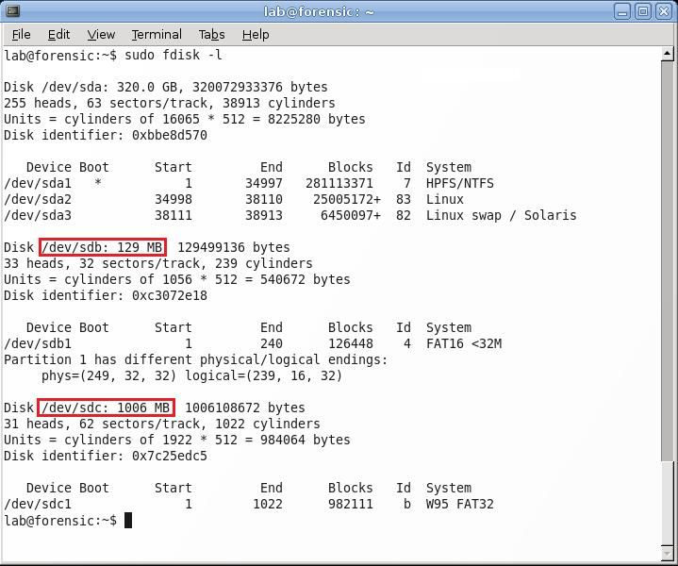
Display Disk Names using fdisk
dcfldd if=/dev/sdb of=/media/disk/test_image.dd hashlog=/media/disk/hashlog.txt
Notes:
In order to image a disk, you need to know the disk name.
For example, in Linux, you can use fdisk to display disk names.
In the example here, there are three disks mounted to the system.
Suppose you want to image the USB drive located at /dev/sdb and the drive that the image will be saved on is /dev/sdc,, also assume the destination drive has been mounted as /media/disk. the output of the hashing (The default is MD5) is saved in a text file named hashlog.txt.
So you can issue the following command

Slide 30
dcfldd options
if = FILE
Input File (the disk)
of = FILE
Output File
bs = SIZE
Block Size (in bytes)
hashlog = FILE
Output to FILE the hash value calculated
conv=sync, noerror
Tells the tool to ignore errors, and to write zero’s in place of the bad block.
[1] Imaging Using dcfldd
https://dfir.blog/imaging-using-dcfldd/

Slide 31
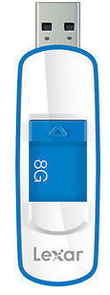

Non-graded hands-on exercise
- Imaging Using dcfldd
Suppose that you find a USB Flash Drive at the crime scene. You are required to image the USB drive using dcfldd on your forensics workstation.
Notes:
Suppose that you find a USB Flash Drive at the crime scene. You are required to image the USB drive using dcfldd on your forensics workstation.

Slide 32
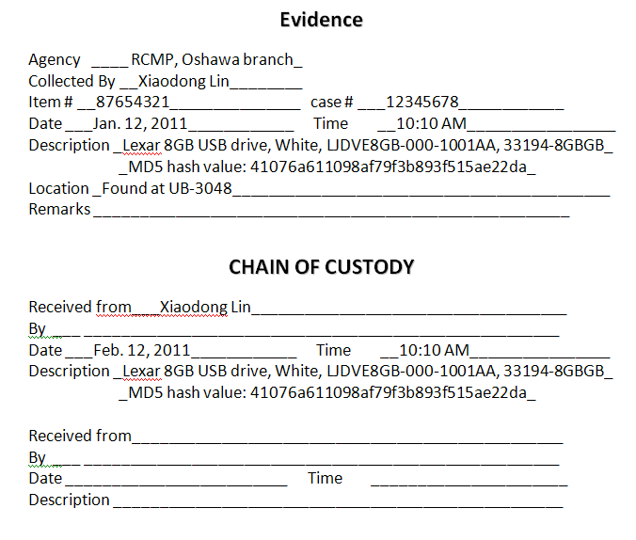
Creating & Maintaining Digital Chain of Custody
Non-graded hands-on exercise
- Imaging Using dcfldd (cont’d)
Your name!
Investigator Paul
Dr. Xiaodong Lin
Notes:
Also, you will need to document it. For example, the appearance of USB flash drive, and most importantly, the hash value of the disk image. Suppose you then pass the evidence to Dr. Xiaodong Lin for analysis.

Slide 33
For data acquisition in a digital investigation, why not simply copy all files from the suspect’s digital storage device(s) instead of imaging the device(s)?
Require special tools
Time-consuming

Slide 34
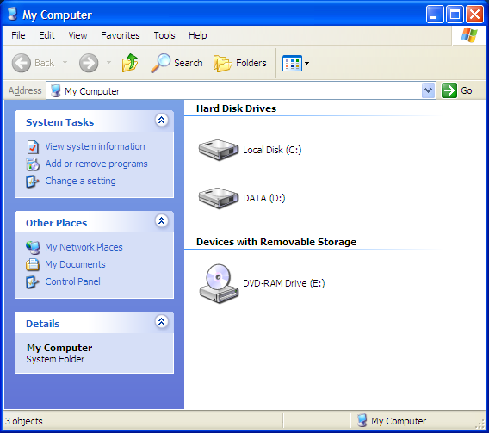
Volume Analysis
Notes:
Hello everyone. In today's lesson, we're going to learn volume analysis.

Slide 35


Evidence Acquisition
Data structures
Analysis Techniques
Law, Ethics and Legal Issues
Notes:
In the last lecture, we already learned how to acquire data or evidence. Next, we need to understand these acquired data or evidence, which is most critical part of a digital investigation. In other words, we will first need to figure out how data are organized o a storage device. Afterwards, we can use different techniques to analyze these data. While it is very critical to know the importance of law, ethics and legal Issues. In this course, we mainly focus on techniques and tools for digital forensic analysis.

Slide 36

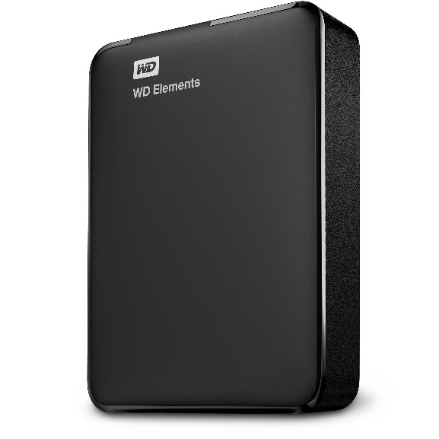
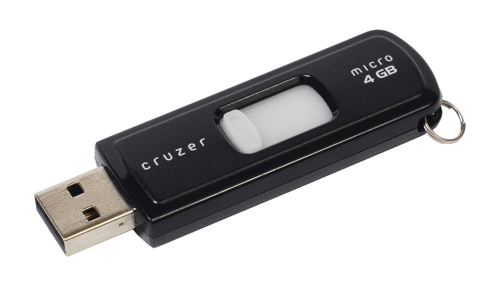

Dose of Reality:
Notes:
As we discussed, unfortunately, illegal activities also take on new forms through the use of digital devices or communication and computer network. Recent media coverage indicates that there is a rapid increase in cyber crimes expected to become increasingly frequent. As such, we look for digital evidence, which is data stored on digital storage devices or could be saved in cloud. For example, the most popular data storage devices are hard disk.

Slide 37

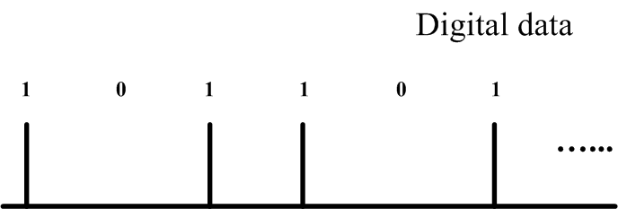
We need to organize these digital data in a way so that it is easy for us to understand and find what we want.
Oops! What is it?
Files
Read data
(media magnetization)
Notes:
Any data stored on data storage devices is just a large collection of bits.
[click]
We need to organize these digital data in a way so that it is easy for us to understand and find what we want. For example, files on your hard disk.

Slide 38
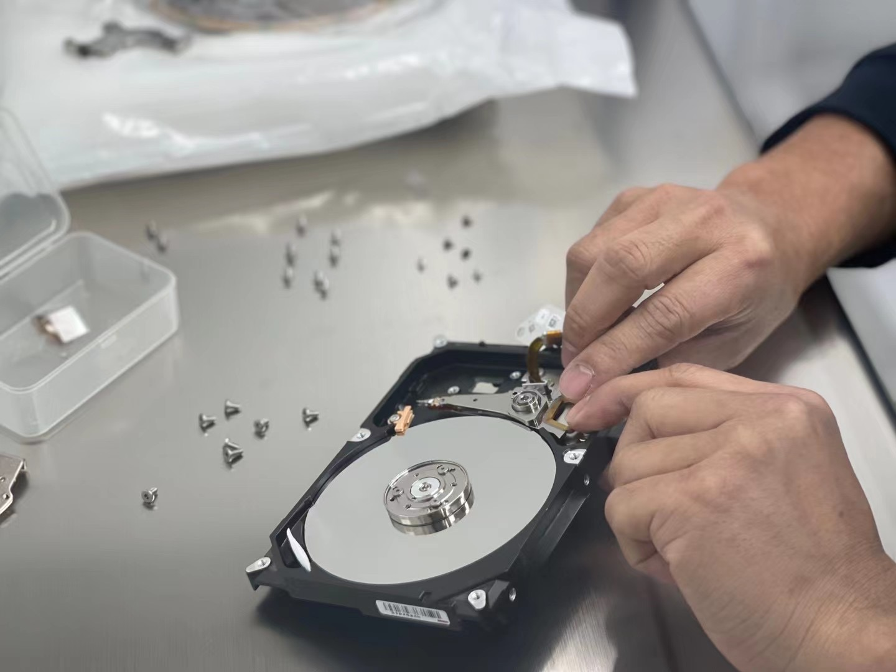
Dose of Reality:

Slide 39
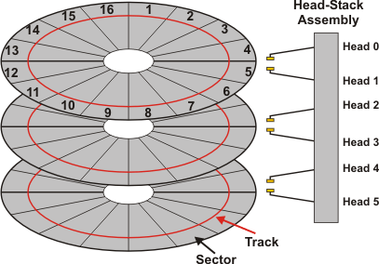
A cylinder
Cylinder-Head-Sector
CHS
or LBA (Logical Block Address)
Notes:
Therefore, we need to understand how data are organized on data storage devices. First, we need to know how today’s popular hard disks are internally structured.
A hard disk drive is organized as sectors. A sector is the smallest physical storage unit on a disk, and is 512 bytes in size. No matter how big a hard disk drive is, a sector is always 512 bytes in size.
[click]
Particularly, If you have a chance to open a hard disk, a hard disk contains a number of platters in a stack. Each platter has two surfaces. One head reads data from the entire surface of each platter. After a disk is low-level formatted (or physical formatting), the surface will be divided into many circular rings, called tracks. Track numbers start at 0, and track 0 is the outermost track of the disk. Each track is further divided into sectors. Each track has the same number of sectors. A cylinder consists of the set of tracks with the same radius on the disk.
[click]
Therefore, we can use cylinder/head/sector (CHS for short) to uniquely identify a sector.
[click]
Today, the cylinder/ head/ sector notation is replaced by LBA (Logical Block Address), which becomes very common today to address one sector on computer storage devices.

Slide 40


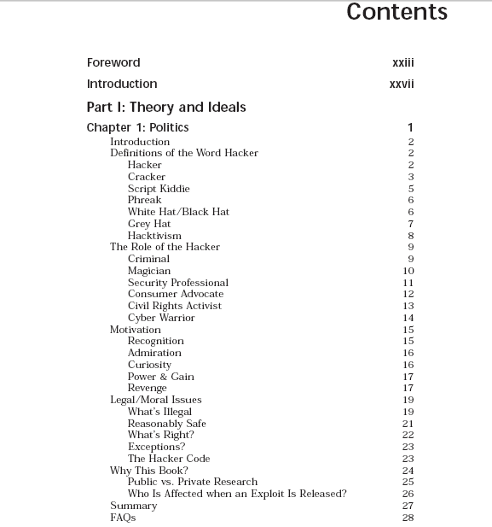

Dose of Reality:
I want to find a file, named readme.pdf
Physical Disk Address
(Cylinder-Head-Sector)
Or LBA
Book
contents
page
number
Notes:
So we now know locate data on sector by sector based on its sector address. However, in real world today, we want to find a file based on its name. There is still a huge gap between sector address and file name.
[click]
Next, let’s take a look at a real world example of how to find a book chapter. Of course, you can flip through the pages and find the chapter you want to read. But, the fastest way is to find look through the contents of a book and find the page number of the chapter. Then, you go to the page number directly.

Slide 41



Disk Block Allocation for files
How do we allocate files on disk so that
we can easily gain access to files
space is utilized effectively
allow accesses that are
Random/Direct: each block can be accessed independently of other
Quick - try to minimize seek time
Notes:
Similarly, we also need to organize these digital data in a way so that it is easy for us to understand and find what we want.
In other words, we need to allocate files on disk so that we can easily gain access to files.
Also, space is utilized effectively.
Further, it should support Random/Direct accesses, but the access is quick.

Slide 42

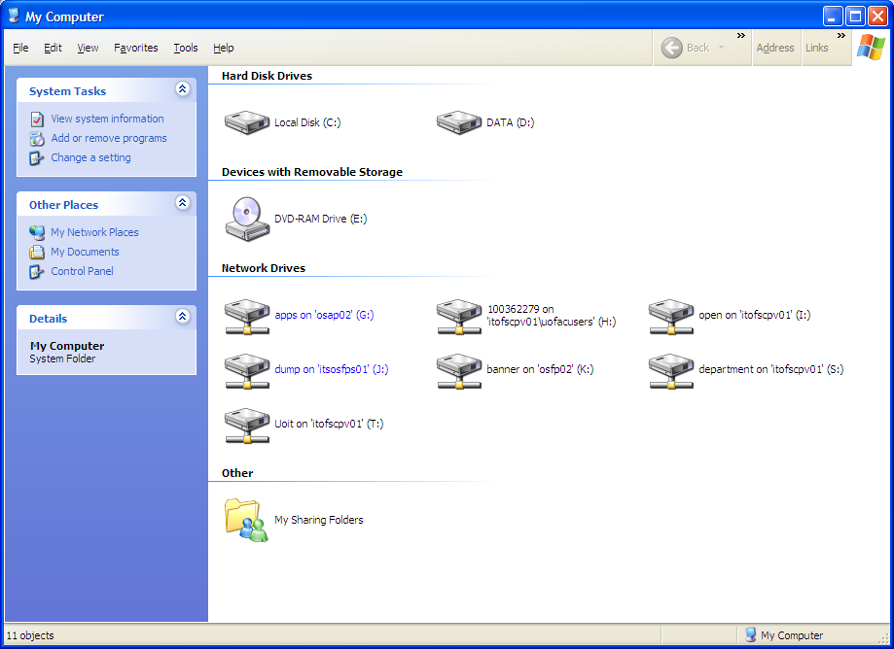

Existing techniques for digital storage media
Volume (logical volume)
Notes:
Next, let’s take a look at existing techniques for digital storage media. A hard disk is usually divided into several parts (partitions), each formatted with a filesystem, called a volume. In the example here, the hard disk is divided into two partitions.

Slide 43
Existing techniques for digital storage media (cont’d)
Volume (physical volume)
Format (usually known as high-level or logical formatting or "making a filesystem")
Partition A
Partition A
split into one or more partitions
Partition B
Partition B
a collection of addressable sectors
Unpartitioned
Free Space
Unpartitioned
Free Space
The term "volume" refers to a disk drive (physical volume) or partition (logical volume).
Notes:
In summary, a hard disk (also known as physical volume) is usually divided into several partitions.
[click]
You can format a partition with a filesystem, also known as making a file system.
Please note that when you partition a hard disk, you don’t have use up all the hard disk space. As a result, some disk space becomes unpartitioned, which can not be accessed by using regular ways in OS.
[click]
Actually, the term "volume" refers to a disk drive (or physical volume) or partition ((or logical volume).
The two terms partition and volume are often used interchangeably on a hard disk, We will follow this tradition unless we specifically say disk volume.

Slide 44
Partitions
A partition is a collection of addressable sectors on storage devices.
Partitions are used in many scenarios, including
Some file systems have a maximum size that is smaller than hard disks.
Many laptops use a special partition to store memory contents when the system is put to sleep.
UNIX systems use different partitions for different directories to minimize the impact of file system corruption.
Intel IA32-based systems (i.e., i386 / x86) that have multiple operating systems, such as Microsoft Windows and Linux, may require separate partitions for each operating system.
Notes:
A partition is a collection of addressable sectors on storage devices.
Partitions are used in many scenarios, including
Some file systems (such as FAT) have a maximum size that is smaller than hard disks.
Create multiple partitions for multiple Oses, one partition for one OS
Separate system from data, one partition for installed system and one or more for data

Slide 45

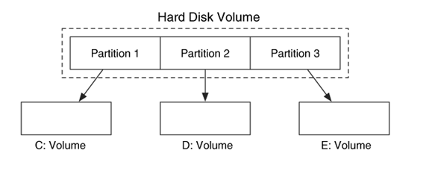
Partitions (cont’d)
Physical Volume
Logical
Volume
An example hard disk volume is organized into three partitions, which are assigned volume names (usually letters, such as C, D, ……).
Notes:
This is an example of hard disk volume which is organized into three partitions, which are assigned volume names (letters C, D, E).
[click]
Sometime, hard disk volume is also known as physical volume, and these partitions refers to logical volumes.

Slide 46

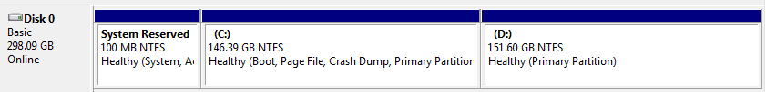
Partitions (cont’d)
Notes:
However, not all partitions or volumes have names and are visible to end users. This is an example of hard disk volume which is organized into three partitions. But, the first partition is hidden, which is used to store your system files that can be used to reset and restore your system. So you only see two volumes C and D.

Slide 47

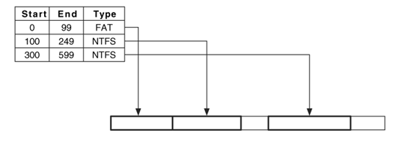

Partition table
The common partition systems have one or more tables, called partition table, and each table entry describes a partition. The data in the entry will have the starting sector of the partition, the ending sector of the partition (or the length), and the type of partition.
An example hard disk volume is organized into three partitions, which are assigned volume names.
Notes:
The common partition systems have one or more tables, called partition table, and each table entry describes a partition. The data in the entry will have the starting sector of the partition, the ending sector of the partition (or the length), and the type of partition, which indicates the file system the partition contains.
In the example here, the first partition occupies 100 sectors, which is a FAT file system.

Slide 48

Partition system and Harddisk Interface
A partition system is dependent on the operating system and not the type of interface on the hard disk. Therefore, a Windows system uses the same partition system regardless if the disk uses an AT Attachment interface (ATA/IDE) or a Small Computer Systems Interface (SCSI).
However, Hard disk Interface is crucial for data acquisition.
Notes:
Next, I need to discuss the difference between Partition system and Harddisk Interface.

Slide 49
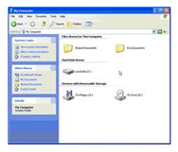
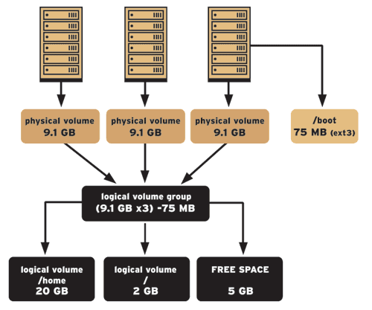
Volume and Operating System (OS)
Notes:
Next, let’s take a look at how different Operating System (OS) manages volume.

Slide 50

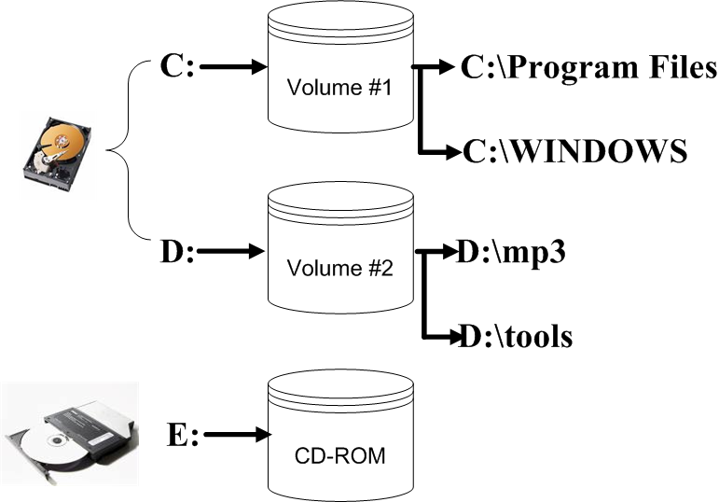
Volumes in Windows and UNIX
Mount points of two volumes and a CD-ROM in Microsoft Windows
Notes:
Windows uses the letters for accessing different partitions (volumes) and storage devices.

Slide 51
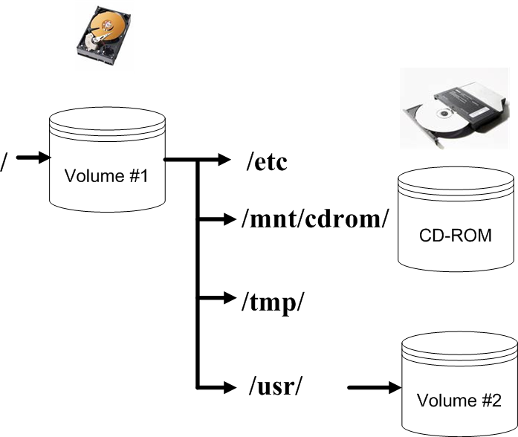

Volumes in Windows and UNIX (cont’d)
Mount points of two volumes and a CD-ROM in a typical UNIX system
Notes:
Different from Windows, However, Unix-like operating systems use a different method of accessing different partitions and storage devices.
Instead, it uses a directory path or folder in the file system.
For example, on Linux, external storage devices were traditionally mounted at /mnt. So, rather than accessing a CDROM drive at D: in Windows, you might access it at /mnt/cdrom in Linux.

Slide 52
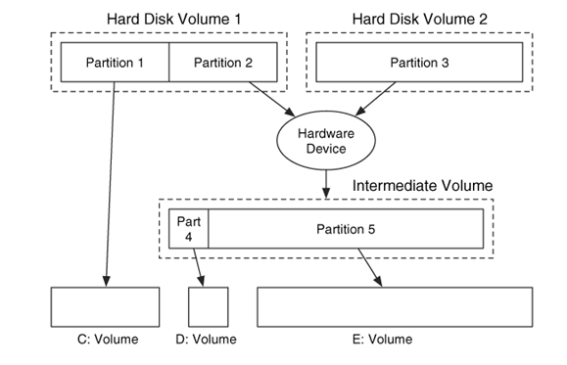
Volume Assembly
A volume system that merges two partitions into one volume and partitions it.
Notes:
Also, multiple partitions or volumes can be merged into one big volume and then partition it again.
In the example here, the hard disk 1 is divided into two partitions, and the hard disk 2 has one partition.
Then, Partition 2 in the hard disk 1 is merged with Partition 3, the partition in the hard disk 2.
The merged intermediate volume is further divided into two partitions.

Slide 53
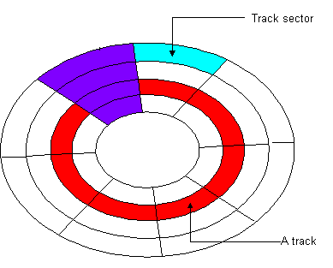
Addressing
Use a sector address to uniquely locate a sector on hard disk.
Cylinder-Head-Sector (CHS)
How about a sector in a partition?
or LBA
Notes:
Next, we will discuss the important addressing issue in a partition.
We already know that we use a sector address to uniquely locate a sector on hard disk, either CHS address or LBA. Please note that LBA becomes common today.
So how to address a sector in a partition?

Slide 54
Addressing scheme
258
100
158
How to address a sector in a volume system.
Use its LBA address, which is a number that starts at 0 at the first sector of the disk. aka the physical address of a sector in a physical hard disk.
A volume is a collection of sectors, and we need to assign an address to them. A logical disk volume address is the address of a sector relative to the start of its disk volume. Aka logical disk volume address. It is the same as LBA address if the disk volume only contains one physical hard disk.
use addresses relative to the start of the partition and not the start of the disk or parent volume. Aka logical partition volume address.
Notes:
In other words, how to address a sector in a hard disk which is partitioned?
Next, we will introduce some terms.
Please note that we use LBA address, which is a number that starts at 0 at the first sector of the disk
First, the LBA address is also known as the physical address of a sector.
In the example here, suppose the hard disk has one partition, with the first 100 sectors and some space in the end unpartitioned. We are interested in one sector in the partition, and its LBA address is 258.
[click]
The second term is logical disk volume address, which is the address of a sector relative to the start of its disk volume. If we are talking about one hard disk here, the physical address of a sector is the same as the logical disk volume address.
[click]
The third term is logical partition volume address, which is the address relative to the start of the partition and not the start of the disk or parent volume. In the example here, logical partition volume address for the sector is 158, not 258.

Slide 55
Addressing scheme (cont’d)
2000
Disk 1
Disk 2
Logical Disk Volume
Notes:
As we just discussed, the physical address of a sector is the same as the logical disk volume address for one hard disk. However, sometime we may merge two hard disks into one big logical disk volume. For example, merge multiple hard drives as one bigger volume using LVM (Logical Volume Management) on Linux. Then, the situation becomes different.
In the example here, we merge two hard drives as one bigger disk volume. The Disk 1 has 2000 sectors.
Obviously, the physical address of the first sector in Disk 2 is Sector 0, but its logical disk volume address is now Sector 2000 instead.

Slide 56


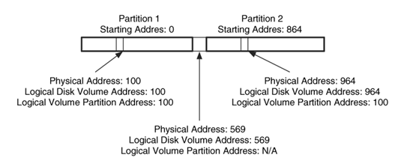
Addressing scheme (cont’d)
A
B
C
The logical partition volume address is relative to the start of the partition while the logical disk volume address is relative to the start of the disk volume.
Notes:
Next, let’s do an in-class test together. Remember that the logical partition volume address is relative to the start of the partition while the logical disk volume address is relative to the start of the disk volume.
In the example here, we have a hard disk divided into two partitions. The first partition starts from the beginning of the hard disk, and the second partition starts at Sector 864.
We have three sectors A, B and C. We know their physical addresses.
What are logical disk volume address and logical partition volume address for Sector A?
[click]
Note that the physical address of a sector is the same as the logical disk volume address for one hard disk.
What are logical disk volume address and logical partition volume address for Sector C?
[click]
Note that the logical partition volume address is relative to the start of the partition. the second partition starts at Sector 864. So logical partition volume address for Sector C is the distance from the start of the second partition to it. So it is 964 – 864 = 100.
What are logical disk volume address and logical partition volume address for Sector B?
[click]
Note that Sector B doesn’t belong to any partition. Therefore, there is no logical partition volume address for Sector B.

Slide 57

Volume Analysis
Notes:
When conducting digital forensic investigations, the most common source of digital evidence is hard disk. Also, a hard disk is usually partitioned.
Therefore, it is very important to conduct volume analysis and figure out the layout of the hard disk.

Slide 58

Volume Analysis Basics
Partition tables must be analyzed
Locate the partition tables and process them to identify the layout, and then provide the partition layout to a file system analysis tool
Identify the partition layout for non-assigned sectors, which can be used to hide data
partition table
The hard disk layout
Notes:
Therefore, we need to analyze partition tables.
Specifically, locate the partition tables and process them to identify the layout of the hard disk. Afterwards, we can analyze the file systems contained in these partitions.
Also, identify the partition layout for non-assigned sectors. These unpartitioned sectors can be used to hide data

Slide 59

Volume Analysis Basics (cont’d)
Partition Consistency Checks
Check each partition relative to other partitions
Partition 1
Partition 2
Notes:
After you figure out the layout of a hard disk, you can do partition consistency checks.
By convention, a disk partition utility usually creates partitions in a way where one immediately follows the other if multiple partitions have to be created on a disk and the partitions occupy the entire disk space.
In principle, partitions should not overlap to each other.
However, something inconsistent could occur due to many reasons, for example, two partitions overlap to each other here, which is wrong.
A further investigation should be launched to determine the cause if there is any inconsistency to the disk layout.

Slide 60
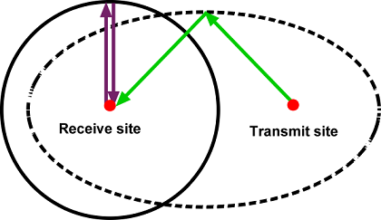
Volume Analysis Basics (cont’d)
Consistency Checks
Partition 1
Partition 2
Partition 1
Partition 2
Notes:
Next, take a look at two possible layouts of a disk, which is divided into two partitions.
In the first scenario, some disk space in the end is left unpartitioned.
In the second scenario, some disk space in the middle is left unpartitioned.
both scenarios are possible, which are valid layouts.

Slide 61
Volume Analysis Basics (cont’d)
Consistency Checks
Partition 1
Partition 2
Partition 1
Partition 2
Notes:
We further take a look at two more disk layouts.
The first scenario here is the most popular one used today. The disk is divided into multiple partitions (e.g., 2), and the partitions occupy the entire disk space.
However, the second scenario here is an invalid layout. Where two partitions overlap to each other.

Slide 62
Volume Analysis Basics (cont’d)
Consistency Checks
Partition 1
Partition 2
Notes:
One more scenario: a disk is divided into two partitions, but the second partition is located within the first one, which is also invalid.
Please note that if you see an invalid disk layout, you must investigate further to figure out what happened.

Slide 63

Volume Analysis Basics (cont’d)
Extracting the Partition Contents
Recovering Deleted Partitions
recovery
Notes:
After we figure out the layout of the disk, we can conduct any further investigation by extracting each individual partition, for example, using dcfldd. These extracted partitions can be further analyzed, for example, using any file system analysis tools, which will be discussed later when introducing file system forensic analysis.
Also, due to various reasons, formatting, or covering up wrongdoing by criminals, a partition could be deleted. Fortunately, when a partition
on a disk is deleted, the partition contents aren’t actually erased.
So we can recover a deleted partition.

Slide 64

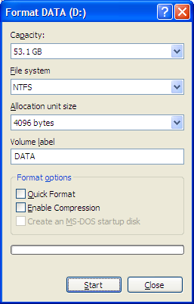
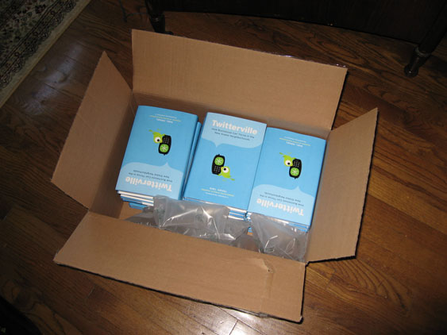
Inside Volume(s)
File system (or filesystem)
Database
Format
Notes:
What is inside these partitions or volumes?
Most likely, a partition contains a file system.
[click]
Remember you format a partition, actually you create a file system on the partition. For example, you create a NTFS file system on a partition.
Also, a partition may contain a Database.

Slide 65
File System
Notes:
We know that a partition contains a file system. A partition must be formatted before you can use it for data storage.

Slide 66

File System
A file system (or filesystem) is a method for storing and organizing computer files and the data they contain to make it easy to find and access them. File systems may
use a data storage device such as a hard disk or CD-ROM and involve maintaining the physical location of the files,
Or they might provide access to data on a file server by acting as clients for a network protocol (e.g., NFS, SMB, or 9P clients),
or they may be virtual and exist only as an access method for virtual data (e.g., procfs).
Logical storage unit a.k.a file
How files are organized?
[1] File system. http://en.wikipedia.org/wiki/File_system
Notes:
A file system (or filesystem) is a method for storing and organizing computer files and the data they contain to make it easy to find and access them.
[click]
In other words, a file system describes how files are organized.

Slide 67
Operating System (OS) and File System
Notes:
You already study both OS and File system in the past. You must know the relationship between them.

Slide 68
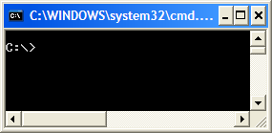
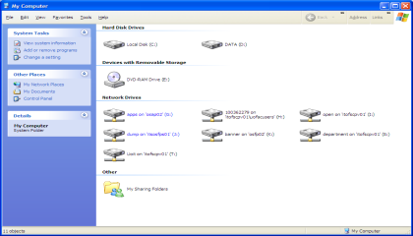
File Systems and Operating Systems
Most operating systems provide a file system (FS), as a file system is an integral part of any modern operating system. A modern operating system usually support mutiple FSes.
An operating system provides an interface for the user to use the file system. This interface can be
textual (such as provided by a command line interface, such as the Unix shell);
graphical (such as provided by a graphical user interface (GUI), such as file browsers).
Notes:
File system is a very important component of an OS, providing end user with a way to access data stored on the disk.
Note that a modern operating system usually support mutiple file systems.
Also, an operating system provides an interface for the user to use the file system, including command line and graphical user interface (GUI for short).

Slide 69
Partition and File System and Volume
Format (usually known as "making a filesystem")
Partition A
Partition A
split into one or more partitions
Partition B
Partition B
Unpartitioned
Free Space
Unpartitioned
Free Space
Notes:
Next, we will summarize what we have learned on how today’s hard disk is organized.
A hard disk is usually divided into several partitions. Each partition is formatted with a file system.

Slide 70
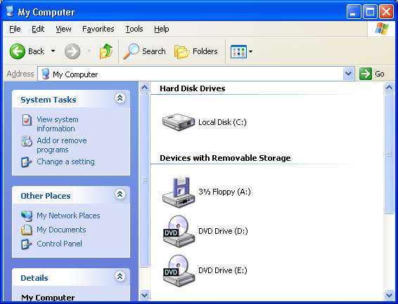
Partition and File System and Volume (cont’d)
used and accessed by an operating system
Partition A
gets a "drive letter."
Partition B
Unpartitioned
Free Space
volume is the term used to describe a single accessible storage area with a single file system, typically (though not necessarily) resident on a single partition of a hard disk.
[1] Volume (computing). http://en.wikipedia.org/wiki/Volume_(computing)
Notes:
After a partition is formatted with a file system, it can be used to store data and be accessed by an Operating System.
For example, in Windows,
Most likely, a partition is formatted with a file system. In OS context, volume is the term used to describe a single accessible storage area with a single file system, typically (though not necessarily) resident on a single partition of a hard disk.
Therefore, the two terms partition and volume are often used interchangeably on a hard disk,

Slide 71

Partition and File System and Volume (cont’d)
File Allocation Table (FAT) File System family (such as FAT, FAT12, FAT16, FAT32)
New Technology File System (NTFS)
Extended file system(ext)* family (such as ext2 and ext3),
etc
Notes:
Some examples of file systems are FAT, NTFS, EXT

Slide 72

Partition and File System and Volume (cont’d)
Volume
This volume is organized into a particular format, i.e., filesystem, database
split into one or more partitions
Partition A
Partition B
Notes:
I would like to emphasize it again: A partition or volume is organized into a particular format, i.e., filesystem, database. It then can be used and accessed by an operating system through either command line interface or GUI provided to the end users.

Slide 73
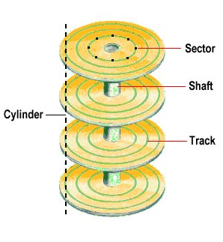
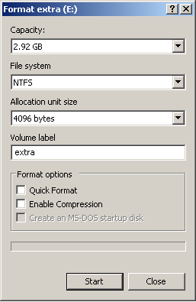
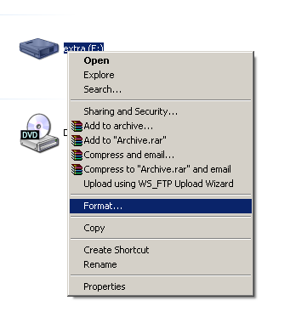
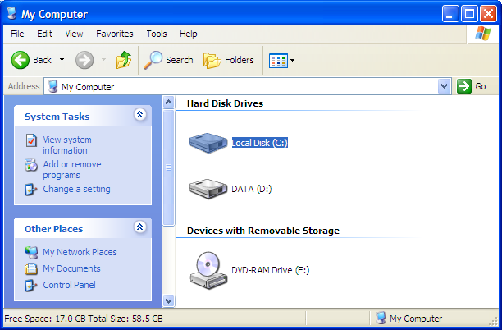
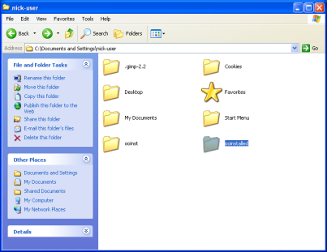
Partition and File System and Volume (cont’d)
split into one or more partitions
Low level format
Partition A
Partition B
Format (or make filesystem)
Notes:
In summary, a hard disk must first go through low-level format to have data storage structure (e.g., sectors) created.
A hard disk is usually divided into several partitions. Each partition is formatted with a file system.
After a partition is formatted with a file system, it can be used to store data and be accessed by an Operating System.

Slide 74
Dose of Reality:
In order to be used in a computer system, a hard disk drive (HDD) must first be partitioned.
But how?
Notes:
In order to be used in a computer system, a hard disk drive (HDD) must first be partitioned.
But how to do it?

Slide 75
MBR vs GPT
Two popular partition systems
Master Boot Record (MBR), aka PC-based or DOS (Disk Operating System)-style partition, and Globally Unique Identifier (GUID) Partition Table (GPT)
MBR partitioning is more popular today
MBR vs GPT
There are a number of differences between MBR and GPT.
Notes:
Currently, there are two popular partition systems: Master Boot Record (MBR), aka PC-based or DOS (Disk Operating System)-style partition, and Globally Unique Identifier (GUID) Partition Table (GPT).
MBR partitioning is more popular today.
There are a number of differences between MBR and GPT.

Slide 76
MBR vs GPT (cont’d)
key differences between MBR and GPT:
GPT supports more primary partitions:
MBR only supports 4 primary partition table entries while GPT supports 128 primary partitions with current Microsoft Windows™ operating systems.
GPT supports much large hard disks:
MBR uses 32-bit values to indicate the starting offset and length of a partition. It means an MBR disk supports 2^32 bit LBAs multiplied by 512 bytes/sectors = 2.19TB maximum disk size. Since GPT uses 64-bit values to indicate the starting offset and length of a partition, a GPT disk can theoretically support up to 2^64 LBAs. It means the maximum capacity of a GPT disk = 9.4 x 10^21 bytes = 9.4 zettabytes (ZB).
Note that 1 sector = 512 bytes
GPT is more reliable:
GPT provides redundancy by writing the GPT header and partition table at the beginning of the disk and also at the end of the disk.
The contents of the GPT header and partition table are also verified via a CRC32 checksum for the header and one for the partition table.
Notes:
There are a number of differences between MBR and GPT.
Overall, there are more advantages using GPT. For example,
GPT supports more primary partitions
GPT supports much large hard disks
GPT is more reliable.

Slide 77
MBR vs GPT (cont’d)
But MBR is simple, and still widely used today.
Notes:
MBR partitioning is very simple, and is used more popular today

Slide 78
PC-based Partitions
Notes:
So we will take a look at MBR Partitions or PC-based Partitions in more details.

Slide 79
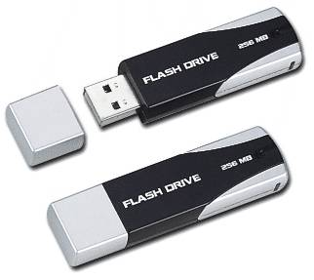
The layout of the DOS (Disk Operating System)-style partition system
Master Boot Record (MBR) disks
Partitions
The first 512-byte sector, called Master Boot Record (MBR)
digital storage devices
Notes:
The layout of the DOS (Disk Operating System)-style partition system is very simple. The first sector is called Master Boot Record (MBR).
[click]
The disks using MBR partitioning are also called MBR disks.

Slide 80
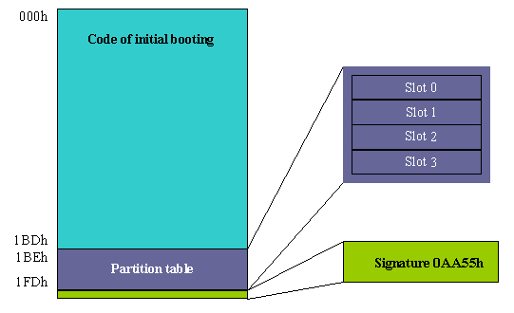
Disk Layout (cont’d)
Master Boot Record (MBR)
First sector on every disk
Location - Track (Cylinder) 0, Side (Head) 0, Sector 1 (or LBA 0)
Contains Partition Table and Master Boot Code (MBC).
Master Boot Code
(MBC)
Notes:
Specifically, MBR is always the first sector of a disk no mater what size it is.
It is LBA 0 or Sector 0.
It contains Partition Table and Master Boot Code (MBC)

Slide 81
Disk Layout (cont’d) Master Boot Code (MBC)
Master Boot Code
Used at Boot time (When Disk Selected for Booting)
Examines Partition Table
Identifies System (Active, Primary) Partition, finds partition’s starting location
Loads copy of Partition Boot Sector into memory
Transfers execution
Notes:
Master Boot Code is the small bit of computer code that the BIOS (basic input/output system) loads and executes to start the boot process. This code transfers control to the boot program stored on the active partition to load the operating system.

Slide 82

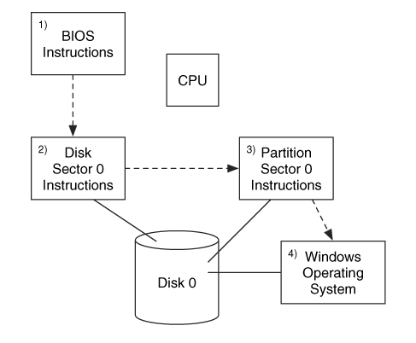
Booting Process
The relationship among the various boot code locations in an IA32 system
Notes:
Recall what you’ve learned about computer booting process.
When you turn on the computer, The the BIOS (basic input/output system) code initializes the hardware.
Then, the BIOS calls the Master Boot Code stored in the MBR.
Afterwards, it loads code from the boot sector of the active partition, starting your OS (e.g., Windows).

Slide 83
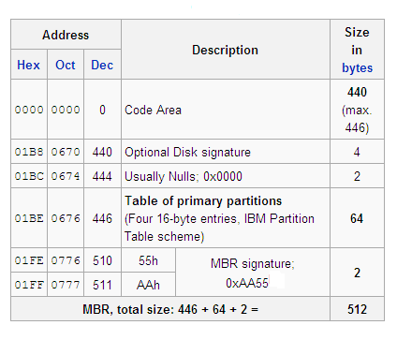

Disk Layout (cont’d) Data Structure of a Master Boot Record
Essential
[1] Master boot record. http://en.wikipedia.org/wiki/Master_boot_record
Notes:
This is how a MBR looks like. First and foremost, the MBR contains a partition table, which is an index of up to four partitions that exist on the same disk.
The final two bytes of the 512-byte MBR are called MBR signature, which is 0xAA55.

Slide 84

Disk Layout (cont’d) Partition Table
The partition table has four 16-byte entries, each of which can describe a DOS partition. Each entry has the following fields:
Starting CHS address
Ending CHS address
Starting LBA address
Number of sectors in partition
Type of partition
Flags
Partition size

Slide 85

Disk Layout (cont’d) Partition Size
Number of sectors in partition (Partition Table)
The sector size
Your OS
Notes:
The number of sectors specifies the size of the partition.
[click]
You know the sector size, which is 512 bytes. So you multiply the number of sectors by 512 bytes, you obtain the size of a partition.

Slide 86
Disk Layout (cont’d) Layout of one 16-byte partition record (Data structure for partition entries)
Essential
Offset | Filed length (bytes) | Description
0x00 | 1 | Bootable Flag (0x80 = bootable, 0x00 = non-bootable, other = invalid)
0x01 | 3 | CHS address of first block in partition. The format is described in the next 3 bytes.
0x01 | 1 | head
0x02 | 1 | sector is in bits 5–0; bits 9–8 of cylinder are in bits 7–6
0x03 | 1 | bits 7–0 of cylinder
0x04 | 1 | partition type
[1] Master boot record. http://en.wikipedia.org/wiki/Master_boot_record

Slide 87
Disk Layout (cont’d) Layout of one 16-byte partition record (cont’d) (Data structure for partition entries)
Offset | Filed length (bytes) | Description
0x05 | 3 | CHS address of last block in partition. The format is described in the next 3 bytes.
0x05 | 1 | head
0x06 | 1 | sector is in bits 5–0; bits 9–8 of cylinder are in bits 7–6
0x07 | 1 | bits 7–0 of cylinder
0x08 | 4 | LBA of first sector in the partition
0x0C | 4 | number of sectors in partition, in little-endian format
[1] Master boot record. http://en.wikipedia.org/wiki/Master_boot_record

Slide 88
Disk Layout (cont’d) Partition Types
Partition type | Description
0x00 | Empty
0x01 | DOS 12-bit FAT
0x07 | Windows NT NTFS
0x82 | Linux swap
0x83 | Linux native partition
…… | ……
[1] Partition types.
http://www.win.tue.nl/~aeb/partitions/partition_types.html#toc1

Slide 89

Disk Layout (cont’d)
A basic DOS disk with two partitions and the MBR
Notes:
This is an example disk layout with two partitions and the MBR.

Slide 90

The MBR is a simple method of describing up to four partitions. However, many systems require more partitions than that?
Notes:
But we have a problem here. The MBR is a simple method of describing up to four partitions. However, many systems require more partitions than that?

Slide 91
The MBR is a simple method of describing up to four partitions. However, many systems require more partitions than that?
The Answer ?
Extended Partition
Notes:
The answer is
[click]
Using extended partition.

Slide 92

Extended Partition Concepts
A DOS disk with three primary file system partitions and one primary Secondary Partition (Extended Partition).
Notes:
This is an example disk layout with three primary partitions and one extended partition.

Slide 93
Extended Partition Concepts (cont’d)
An Extended Partition is a type of partition that you can create only on basic master boot record (MBR) disks.
Extended Partitions are useful if you want to create more than four volumes on a basic MBR disk. Unlike primary partitions, you do not format an extended partition with a file system and then assign a drive letter to it. Instead, you create one or more logical drives within the extended partition. After you create a logical drive, you format it and assign it a drive letter.
An MBR disk can have up to four primary partitions, or three primary partitions, one extended partition.
[1] Extended Partition.
http://www.real-knowledge.com/extended-partition.htm
Notes:
An Extended Partition is a type of partition that you can create only on basic master boot record (MBR) disks.
Unlike primary partitions, you do not format an extended partition with a file system and then assign a drive letter to it. Instead, you create one or more logical drives within the extended partition.

Slide 94


Extended Partition Concepts (cont’d)
The basic theory and layout behind the secondary extended and file system partitions.
Notes:
Technically speaking, you treat an extended partition like a hard disk (or virtual disk). So you can partition the extended partition (or virtual disk) to several partitions.

Slide 95



Extended Partition Concepts (cont’d)
sector 0
The layout required for a disk with six file system partitions
Notes:
For example, you may partition a hard disk in such a way to obtain six file system partitions.
First, you partition a hard disk into three primary partitions and one extended partition.
[click]
Then, you partition the extended partition into one primary partition and one extended partition.
[click]
Then, you partition the extended partition into one primary partition and one extended partition.
[click]
Finally, you partition the extended partition into one primary partition.
Note that you can not create a file system on an extended partition.

Slide 96
Let us have a look at an example

Slide 97

Data Structure of a Master Boot Record (MBR)
Partition Table
16 bytes
1
2
3
4
[1] Master boot record. http://en.wikipedia.org/wiki/Master_boot_record
Notes:
Recall that the MBR contains a partition table, located at byte offset 0x01BE.
[click]
The partition table has four 16-byte entries,

Slide 98



Address
offset
Content
partition type
NTFS
partition size
0x07c7be51*512B
=130530897*512B
=62.24198 GB
No partition!
Notes:
So we first locate the partition table, which is located at byte offset 0x01BE. It has four 16-byte entries.
[click]
You may notice that some partition table entry’s 16-byte value is all 0, it means that the corresponding partition doesn’t exist.
[click]
In the example here, two partitions (the third and fourth ones) don’t exist.
Also, note that the final two bytes of the 512-byte MBR are called MBR signature, which is 0xAA55.
Also, please note that since we use Intel CPU, we use little endian to store multiple bytes data. We have to flip over the raw data to get its actual value. It means that the lower-order byte or least significant byte of a number is stored at the lowest address, and the high-order byte or most significant byte at the highest address in memory.
[click]
We take a look at the first partition in more detail. Note that one partition entry has 16 bytes, from byte 0 to byte 15 or 0x0f.
[click]
In one partition entry, data at byte offset 4 stands for partition type, which is 0x07. It means NTFS file system.
[click]
The final four bytes is the partition size in the number of sectors. Note that we use little endian to store multiple bytes data. We have to flip over the raw data to get its actual value. We read the raw data from the lowest address to the highest address in memory, but the actual value is in reverse order, which is 0x07c7be51, multiply by 512 bytes, you obtain the size of a partition in bytes. You convert it into GB, which 62GB.

Slide 99

Size and file system?
Notes:
The example MBR is from one of my laptops. You can see that the C volume matches the first partition we have investigated.

Slide 100
The location of the partitions
MBR
Partitions
digital storage devices
Notes:
Also, we want to know the location of the partitions so we can figure out the layout of the hard disk.
[click]
A partition can be located in two ways:
1. the starting point and length of the partition
2. the starting and end points of the partition

Slide 101

CHS Address and LBA Address
Starting point
Ending point
Size
The layout of one 16-byte partition record
Notes:
Please note that a sector can be addressed using CHS (Cylinder-Head-Sector) address and LBA (Logical Block Address) address.
[click]
It can be observed that a partition record gives the starting point of a partition in both CHS (Cylinder-Head-Sector) address and LBA (Logical Block Address) address.
[click]
Next, you can find the exact location of the partition by taking a look at either the ending CHS address or the size of the partition in the number of sectors.

Slide 102
CHS Address - Starting CHS address
0x010100
Raw data (3 bytes)
C:0,
H:1,
S:1
Byte 1
Byte 2
Byte 3
7
6
5
0
Head
(1 byte)
Sector
(6 bits)
Cylinder
(10 bits)
7
0
5
0
9
8
7
0
0x01=1
0b000001
= 1
0b00
0b00000000
0b0000000000 = 0
Notes:
Next, we use Starting CHS address as an example. Each CHS address has 3-bytes.
[click]
The Head occupies one byte, the first byte.
[click]
The Sector has 6 bits, using bits 5-0 in the second byte.
[click]
The Cylinder has 10 bits, using the third byte as its low 8 bits and bits 7-6 in the second byte as its top two bits.
[click]
Now, we obtain the raw data of Starting CHS address, 0x010100.
[click]
We have Head=0x01=1, [click] Sector=0b000001=1, and [click] Cylinder=0b00 00000000=0
[click]
So the Starting CHS address is C:0,H:1,S:1

Slide 103
Starting LBA Address
0x3f000000
Raw data (4 bytes)
Starting LBA Address is
0x0000003f = 63
Notes:
So the second last four bytes are Starting LBA address. This is the raw data for the Starting LBA address.
Since we use little endian byte order here to store multiple bytes data. We have to flip over the raw data to get its actual value.
So the real starting LBA address is 0x0000003f, which is Sector 63.

Slide 104
The location of the partitions (cont’d)
MBR
Sector 63
130530897 sectors
1st Partition
Notes:
So we know the location of the first partition. Of course, you also easily figure out the location of the second partition. I will leave it to you as a non-graded hands-on exercise.

Slide 105
Non-graded hands-on exercise
The location of the partitions
MBR
Sector ?
? sectors
2nd Partition
Notes:
In this non-graded lab exercise, you are required to figure out the location of the second partition in the example.

Slide 106





Removable Media
Notes:
In addition to hard disk, there are many different types of Removable Media. How are they structured?

Slide 107
Removable Media
Most removable media also have partitions, and use the same structures that hard disks use. However, by default, they only have one partition in the fourth slot.
For example, by default, a USB flash drive is detected by Windows XP/Vista as removable media and thus will not display more than one partition. In addition, Windows will not allow you to multi-partition removable media.
What if we want multi-partition removable media and a bootable USB device?
In order for this to happen, we need to flip the Removable Media Bit (RMB) on the USB Device. This will tell Windows that the flash drive is a fixed disk and not removable media. For example, Lexar has a tool for this purpose.
Notes:
Most removable media (e.g., USB flash drive) also have partitions, and use the same structures that hard disks use. However, by default, they only have one partition in the fourth slot.
By default, Windows will not allow you to multi-partition removable media.
What if we want multi-partition removable media and a bootable USB device?
In order for this to happen, we need to flip the Removable Media Bit (RMB) on the USB Device. This will tell Windows that the flash drive is a fixed disk and not removable media. For example, Lexar has a tool for this purpose.

Slide 108


Removable Media (cont’d)
Floppy disks that are formatted for FAT12 in a Windows or UNIX system. They do not have partition tables, and each entire disk is treated like a single partition.
Most CDs use the ISO 9660 format so that multiple operating systems can read the contents of the CD.
Recordable CDs, or CD-Rs, have a notion of a session. A CD-R can have one or more sessions on it, and the purpose of the sessions is that you can continue to add data to CD-R more than once.
Each session may show up as though it was a partition, but without having partition tables.

Slide 109
Removable Media (cont’d)
CD Recording sessions
A CD has 3 areas: lead-in, actual data, lead-out.
Lead-in includes the table of contents (TOC): directory, indices to individual tracks, each track is a group of sectors that are written to the CD at one time.
Data area include all tracks where actual data is stored.
Lead-out marks the end of the data area.
Multiple sessions of lead-in, data, lead-out can be written separately over time.
During 1 write activity, all data for a session are written with their table of contents, after which the session can be played on any CD player.
Lead-in
Lead-in
...
Information
Lead-out
Information
Lead-out
Session 1
Session 2
Notes:
28

Slide 110


Removable Media (cont’d)
Erase a CD RW (or DVD)
Rewritable CDs (for example, CD-RW discs) and rewritable DVDs (for example, DVD-RW, DVD+RW, or DVD+RAM) can be erased and written to many times.
a full erase of a CD-RW deletes all data on a disc, but a quick erase will only remove all references to tracks and sessions.
Therefore, it is possible to recover the data on a CD-RW. When a full erase has been executed, the data cannot be recovered.
Lead-in
Lead-in
...
Information
Lead-out
Information
Lead-out
Session 1
Session 2
Notes:
28

Slide 111


Another quick operation?
Notes:
Does any of this sound familiar to you? When you format a partition, you also have an option to do a quick format.
In this case, only file system data structures are created, but the contents of the old files still exist and the volume could be re-built to gain access.
How about a full format? Compared to a quick format, a Full Format runs an additional step that checks the hard drive for any bad sectors. So it is very slow if we are formatting a big partition. However, the contents of the old files still exist and the volume could also be re-built to gain access.

Slide 112

Recovering Deleted Partitions
recovery
Notes:
If we delete a partition, the deleted partition becomes invisible, but can be still recovered.

Slide 113

Discussion
Why Volume Analysis?

Slide 114

The Sleuth Kit (TSK) and Autopsy Browser
Linux toolkit for forensics written by Brian Carrier
http://www.sleuthkit.org/

Slide 115

The Sleuth Kit
Autopsy
html-based front-end to TSK for both live and dead analysis
works as a web server (allows a remote repository of images)
Notes:
TSK is a collection of Linux tools that perform different aspects of a file system analysis, including disk tools, volume tools, file system tools, and searching tools.
The Autopsy Forensic Browser is a graphical user interface that provides a user friendly interface to the command line tools contained within TSK.

Slide 116


Notes:
For example, TSK provides a utility called mmls to displays the layout of the partitions in a disk volume system. This is an example output of the mmls tool

Slide 117

Reading materials
Chapters 3, 4
The Master Boot Record (MBR) and Why it is Necessary?
http://www.dewassoc.com/kbase/hard_drives/master_boot_record.htm
Convert an MBR disk into a GPT disk
https://docs.microsoft.com/en-us/windows-server/storage/disk-management/change-an-mbr-disk-into-a-gpt-disk

